Slide 1

DETECTION OF DEGREE OF STRESS USING MACINE LEARNING
Guided by - V.Sravan Kumar
Done by –
CH Nehanth Reddy -18071A12D4
G Siva Sai Teja -18071A12E0
P Bharath -18071A12G0
P Shiva Prasad-18071A12G1

Slide 2
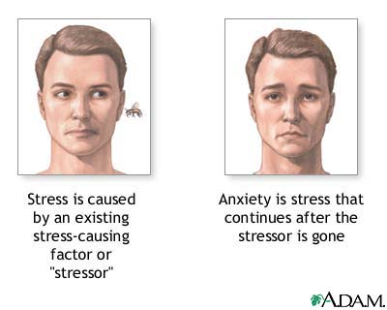
WHAT IS STRESS?
Stress is a feeling of emotional or physical tension. It can come from any event or thought that makes you feel frustrated, angry, or nervous. Stress is your body's reaction to a challenge or demand. In short bursts, stress can be positive, such as when it helps you avoid danger or meet a deadline.

Slide 3
ABSTRACT
Every year tens of millions of people suffer from depression and few of them get proper treatment on time and some of them are not. This depression is the result of heavy stress .Every nine out of ten are suffering with stress because of work-overload ,family problems etc.. So, it is necessary to know whether the person is stressed if then he/she should be treated before stepping into danger situation which leads to problems like Heart Stoke, Depression etc

Slide 4
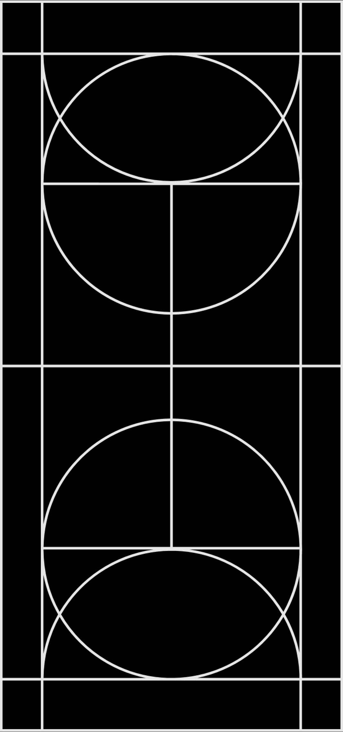
AIM
We developed a AI model which will detect the degree of one’s stress and provide them appropriate suggestions based on there stree level..
We deployed the model using the web-application which is user-friendly and easily understandable.

Slide 5
Existing System : There are many machines like ECG etc..for detection of stress.But for a normal or a busy person finds no time for ECG testings So it is neccessary to develop a mobile application which uses normal data and detects the degree of stress.
Proposed System :
In the proposed system we created a ML model by feeding it with dataset which contains simple and understandable columns like gender,family_history etc..Then we deployed these model using web application so everyone can access it anywhere and know about there stress level easily just through there mobile without giving there time for going around hospital’s.

Slide 6
Steps Involved :
These are the following steps that are involved during building of model :
Importing Dataset
Data Cleaning and conversion
Training model using the dataset
Checking Accuracy
Deployment

Slide 7
Libraries used
import pandas as pd-it offers data structures and operations for manipulating numerical tables and time series.
import numpy as np- NumPy is a Python library used for working with array
import matplotlib.pyplot as plt- used for creating static, animated, and interactive visualizations in Python
import seaborn as sns-data visualization library based on matplotlib.It provides a high-level interface for drawing attractive and informative statistical graphics.
from sklearn.metrics import confusion_matrix- it is a tabular summary of the number of correct and incorrect predictions made by a classifier.
from sklearn.preprocessing import LabelEncoder-It converts Categorical values into numeric values.
import statsmodels.api as sm-statsmodels is a Python module that provides classes and functions for the estimation of many different statistical models, as well as for conducting statistical tests
from sklearn.preprocessing import StandardScaler-it will transform your data such that its distribution will have a mean value 0 and standard deviation of 1.

Slide 8
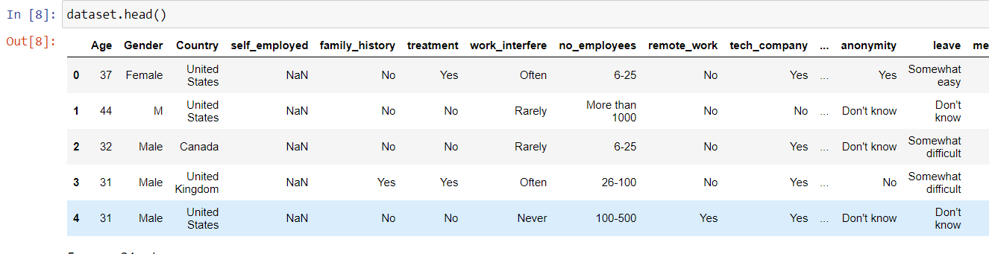
1.OUR DATASET
we collected the dataset for our model through kaggle..
NOTE:SINCE OUR DATASET IS HUGE WE ARE ATTACHING THE HEAD OF THE DATASET

Slide 9
About Dataset :
Our dataset contains the columns which are just the questions that are asked to the individuals who have stress and who does not.
Since , it is the data or answers taken from different individual’s so the way of answering questions is different by each one.
The questions that are asked includes age, gender , family_history , self_employed ,previous_treatment,work_stress etc... 21 questions.
These 21 questions constitute to 21 columns in our dataset.

Slide 10
2.Data Cleaning and Conversion :
After importing the dataset and analysing it we came to know that each individual given the answers as there wish ...But it is our responsibility to convert the answers into meaningfull and machine understandable manner i.e into numericals .we used the following techniques for conversion:

Slide 11
Conversion :
Removed the Time Stamp ,State and Comments column since it won’t show much effect the output value.
Replacing the null values of integer type with 0 and object type columns with a string NAN .
Gender column consist of answers like male,m,female,f,M,F,T, trans etc...converted them to standard types i.e..male,female,trans.
Other columns like family_history , self employed are converted into 0’s and 1’s with Label Encoder.
After converting all the columns into numerical and understandable manner we shown some graphical representations and correlation with output column.

Slide 12
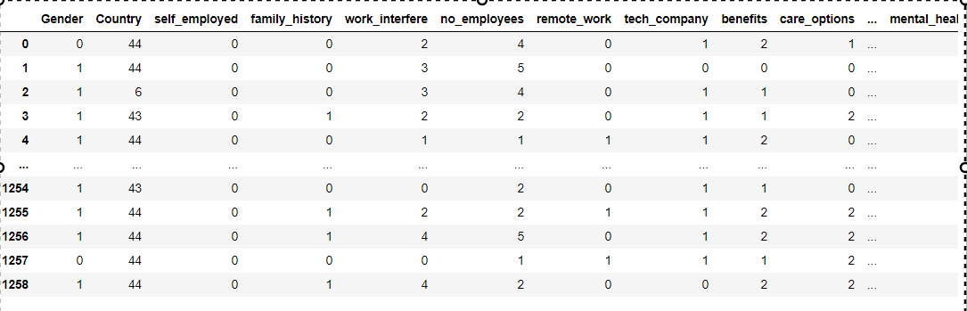
After converting the data into numerical format the dataset looks like :

Slide 13
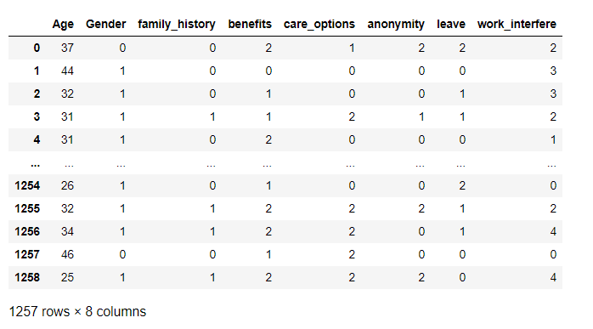
Extracting Features :
After converting the dara we extracted the important features by using the method p-scale :
p-scale is defined as the relation of each column with the output column ..In this procedure we will get to know the r-squared and adjusted r-squared error’s based on this values difference we will drop the columns step wise based on the probability value of each column association with output column ..
If the difference is >0 then associated probability columns values >0.05 then those columns will get removed or dropped..
After doing the above procedure untill the difference is 0 we are left with the columns :
'Age', 'Gender', 'family_history', 'benefits', 'care_options', 'anonymity', 'leave', 'work_interfere' .

Slide 14

ALGORITHMS USED :
After getting the data cleaned we divided the data into trainset and testset by using the function train_test_split present in scikit library.
We used different Supervised ML algorithms like Decision Tree Classifier , Naive Bayes ..

Slide 15
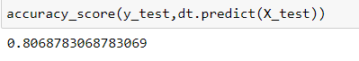
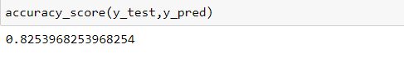
Algorithms along with their accuracies :
Decision tree classifier :80%
Naive Bayes :82%

Slide 16
Model Deployment
The last step that we are left with is deploying the saved model .
We deployed our model using web application which is operated using the python launguage by creating a local host..
Details about the user interface is shown int the next slides along with some sample inputs that we given to check the working ..
Results :
If 0 : then it display’s your stress level is normal no need of worrying.
if 1: then it display’s your stress level is above average and suggest the user to take neccessary precautions .Precautions and effects can be known by clicking on the link present on the screen.

Slide 17

OUR USER INTERFACE:

Slide 18
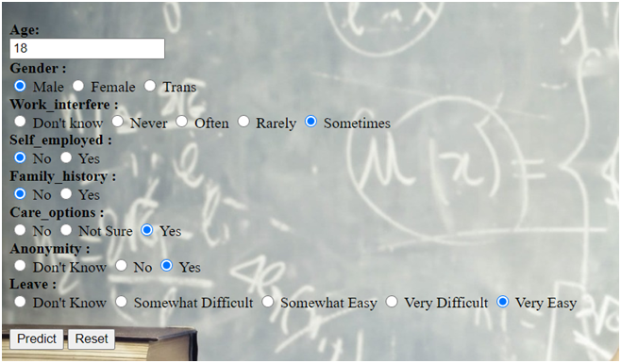
SOME USER INPUTS AND ITS PREDICTION

Slide 19
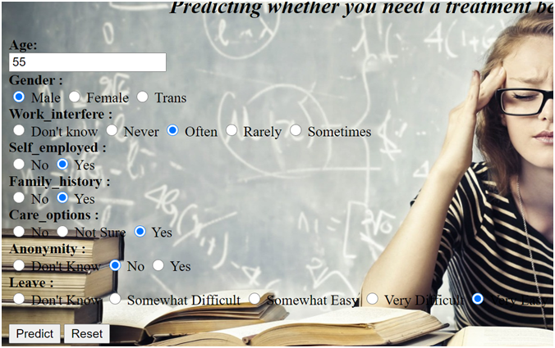
2)

Slide 20
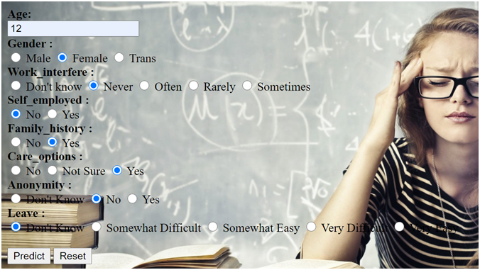
3)

Slide 21
Future Scope
Instead of using this web application we will try to create an android application so it will be easy to use.
We are getting an accuracy of 82% so to increase the dataset need some more highly correlated columns.

